Slide 1
UNIT -2
THREATS

Slide 2
WHAT IS THREAT?
In computer security, a threat is a possible danger that might exploit a vulnerability to breach security and therefore cause possible harm.
A threat can be either "intentional" (i.e. hacking: an individual cracker or a criminal organization) or "accidental" (e.g. the possibility of a computer malfunctioning, or the possibility of a natural disaster such as an earthquake, a fire, or a tornado) or otherwise a circumstance, capability, action, or event.

Slide 3
NEW TECHNOLOGIES OPEN DOOR TO THREATS
All organizations have IS that use integrated technologies such as network of computers, company intranet and internet access to communicate and transfer information for rapid business decisions, thereby opening the organization to the external world like never before.
In these circumstances threats from outside the organization must be addressed because damages can result in great consequences for the organization.

Slide 4
TERMS
THREAT: Anything that can exploit a vulnerability, intentionally or accidentally, and obtain, damage, or destroy an asset.
(A threat is what we’re trying to protect against.)
Vulnerability – Weaknesses or gaps in a security program that can be exploited by threats to gain unauthorized access to an asset.
(A vulnerability is a weakness or gap in our protection efforts.)
Risk: The potential for loss, damage or destruction of an asset as a result of a threat exploiting a vulnerability.
(Risk is the intersection of assets, threats, and vulnerabilities.)

Slide 5
TERMS
Asset: An asset is what we’re trying to protect.
Counter Measures: Set of actions implemented to prevent threats.

Slide 6
INFORMATION LEVEL THREAT
Threats that involve the dissemination of information in such away that organization, their operations and their reputations may be effected.
Dissemination may be active in case of sending an e-mail or it may be passive as in case of setting up websites.

Slide 7
NETWORK LEVEL THREAT
In order to make threat effective ,potential attackers require network access to corporate computer system or to network used by corporate computer systems.
Other security issues involved when data are transmitted over network are confidentiality , authentication, integrity and non-repudiation.

Slide 8
Examples
Information level threat: SQL Injection
Network level threat: DOS attack (flooding accounts with large quantities of e-mail is a network based attack)

Slide 9
Four principal sources of risk
Human error: disclosure of confidential information.
Computer abuse or crime: when a person intends to be malicious and starts to steal information from sites.
Natural and political disasters: This can happen in the form of natural calamities and wars.
Failure of hardware or software: server malfunctioning, software errors etc.

Slide 10
Computer crime : It is defined as any illegal act in which a computer is used as the primary tool.
Computer Abuse: It is unethical use of a computer.
Some threat terms:
Impersonation: The impersonator enjoys the privileges of a legitimate user by gaining access to a system by identifying oneself as another person after having defeated the identification and authentication controls employed by the system.

Slide 11
Trojan horse method: Concealing with an authorized program a set of instructions that will cause unauthorized actions.
Logic Bomb: Unauthorized instructions which stay dormant until a specific event occurs, at which time they bring into effect an unauthorized act.
Computer virus: Segment of code that are able to perform malicious acts and insert copies of themselves into other programs in the system.

Slide 12
DOS: Rendering the system unusable by legitimate user.
Dial Diddling: Changing data before or during input, often to change the contents of database.
Salami Technique: Diverting small amount of money from a large number of accounts maintained by the system.
Spoofing: Configuring a computer system to masquerade as another system over the network in order to gain unauthorized access to the resourses of the system.

Slide 13
Data leakage: There are variety of methods for obtaining data stored in the system.
Super Zapping: Using a system’s program that can bypass regular system control to perform unauthorized acts.
Wiretapping: Tapping computer TC lines to obtain information.

Slide 14
THREAT PROFILE
Threats consist of following properties:
Asset: Something of value to the organization.
Actor: who or what may violate the security requirements(CIA)
Motive: indication of whether the actor’s intentions are deliberate or accidental.
Access: how the asset will be accessed by the actor.
Outcome: the immediate result of violating the security requirements of an asset.

Slide 15
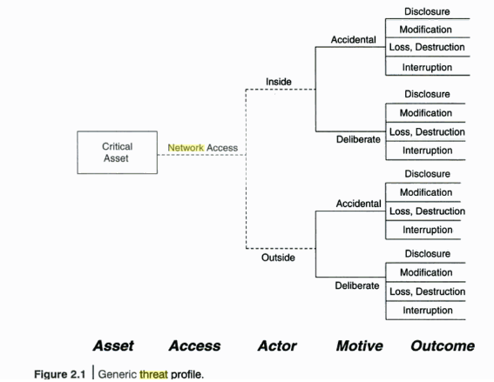

Slide 16
ASSET TYPES(logical and physical)
Information: document data or intellectual property used to meet the mission of an organization.
Software: software applications and services that process ,store or transmit information.
Hardware: IT physical devices considering their replacement costs.
People: people in organization that possess skills,competencies,knowledge and experience that are difficult to replace.
Systems: IS that process and store information.

Slide 17
IMPACT OF THREAT ON INFORMATION SYSTEM
Impact can be financial, in form of immediate costs and losses of assets.
For example: the cost of downtime per hour caused by a DOS attack can be computed by measuring the loss of:
Productivity:(no. of employees impacted)*(hours wasted)* (burdened hourly rate)
Revenue: direct loss and lost future revenue.
Financial performance: credit rating and stock price.
Other expenses: equipment rental overtime costs, extra shipping costs ,travel expenses etc.

Slide 18
PROTECTING INFORMATION SYSTEM SECURITY
Information system controls are classified as follows:
Preventive Controls: Prevent an error or an attack from taking effect.
Detective Controls: Detect a violation. These controls exist to detect and report when errors , omissions and unauthorized use or entry occur.
Corrective control: detect and correct an exceptional situation. These controls are designed to correct errors, omisions and unauthorized users and intruders once they are detected.

Slide 19
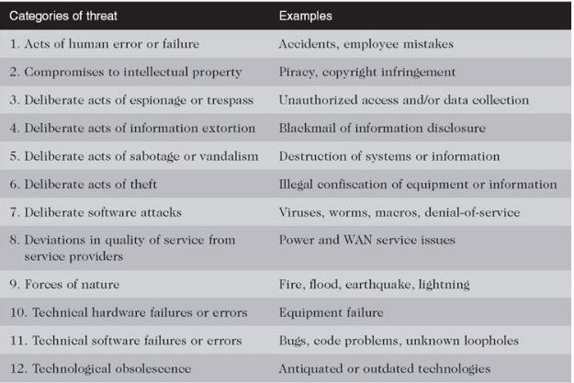
THREATS TO INFORMATION SYSYTEM

Slide 20
SOME EXAMPLES OF INFOSEC THREATS
hacktivism
Hacktivism is the act of misusing a computer system or network for a socially or politically motivated reason. Individuals who perform hacktivism are known as hacktivists.
Hacktivism is meant to call the public's attention to something the hacktivist believes is an important issue or cause, such as freedom of information or human rights. It can also be a way for the hacktivists to express their opposition to something by, for instance, displaying messages or images on the website of an organization they believe is doing something wrong.

Slide 21
SOME EXAMPLES OF INFOSEC THREATS
advanced persistent threat (APT)
An advanced persistent threat (APT) is a prolonged and targeted cyberattack in which an intruder gains access to a network and remains undetected for an extended period of time. The intention of an APT attack is usually to monitor network activity and steal data rather than to cause damage to the network or organization

Slide 22
SOME EXAMPLES OF INFOSEC THREATS
whaling attack (whaling phishing)
A whaling attack is essentially a spear-phishing attack but the targets are bigger – hence whale phishing.
Cybercriminals use whaling attacks to impersonate senior management in an organization, such as the CEO, CFO, or other executives, hoping to leverage their authority to gain access to sensitive data or money.

Slide 23
SOME EXAMPLES OF INFOSEC THREATS
These attackers want to use the authority and influence of the whale to convince people not to look at or question the fraudulent request.
When employees don’t look too hard at the email address or websites and just follow directions, cybercriminals can make out like bandits.

